Slide 1

David M. Kroenke and David J. Auer Database Processing: Fundamentals, Design, and Implementation
Chapter Four:
Database Design Using Normalization

Slide 2
Chapter Objectives
To design updatable databases to store data received from another source
To use SQL to access table structure
To understand the advantages and disadvantages of normalization
To understand denormalization
To design read-only databases to store data from updateable databases

Slide 3
Chapter Objectives
To recognize and be able to correct common design problems:
The multivalue, multicolumn problem
The inconsistent values problem
The missing values problem
The general-purpose remarks column problem

Slide 4
Chapter Premise
We have received one or more tables of existing data.
The data is to be stored in a new database.
QUESTION: Should the data be stored as received, or should it be transformed for storage?

Slide 5
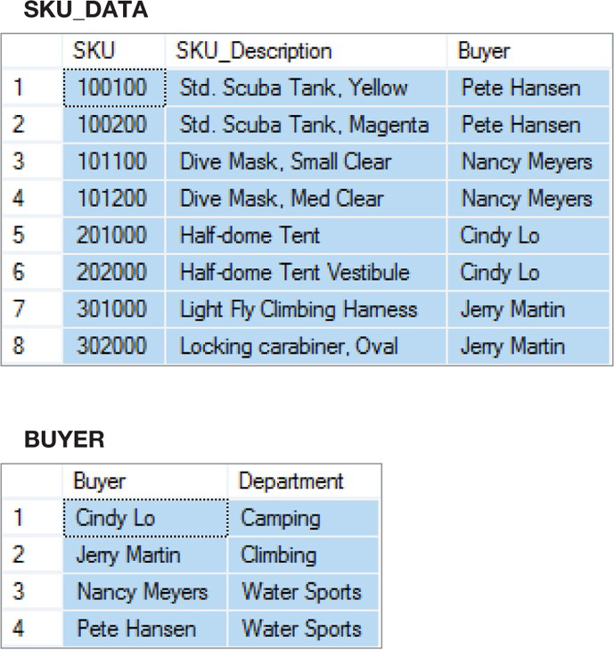
How Many Tables?
SKU_DATA (SKU, SKU_Description, Buyer)
BUYER (Buyer, Department)
Where SKU_DATA.Buyer must exist in BUYER.Buyer
Should we store these two tables as they are, or should we combine them into one table in our new database?

Slide 6
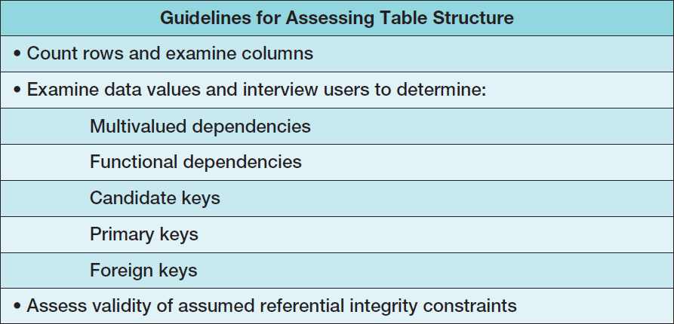
Assessing Table Structure

Slide 7


Counting Rows in a Table
To count the number of rows in a table use the SQL COUNT(*) built-in aggregate function :

Slide 8

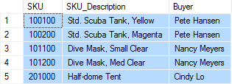
Examining the Columns
To determine the number and type of columns in a table, use an SQL SELECT statement.
To limit the number of rows retrieved, use the SQL TOP {NumberOfRows} function:

Slide 9
Checking Validity of Assumed Referential Integrity Constraints I
Given two tables with an assumed foreign key constraint:
SKU_DATA (SKU, SKU_Description, Buyer)
BUYER (Buyer, Department)
Where SKU_DATA.Buyer must exist in BUYER.Buyer

Slide 10
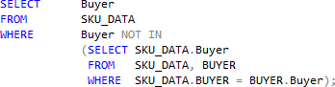

Checking Validity of Assumed Referential Integrity Constraints II
To find any foreign key values that violate the foreign key constraint
An empty set for the query result indicates that no foreign key values violate the foreign key constraint

Slide 11
Type of Database
Updateable database, or read-only database?
If updateable database, we normally want tables in BCNF.
If read-only database, we may not use BCNF tables.

Slide 12
Designing Updatable Databases
Updatable databases are typically the operational databases of a company, such as the online transaction processing (OLTP) system discussed for Cape Codd Outdoor Sports at the beginning of Chapter 2.
If you are constructing an updatable database, then you need to be concerned about modification anomalies and inconsistent data.
Consequently, you must carefully consider normalization principles.

Slide 13
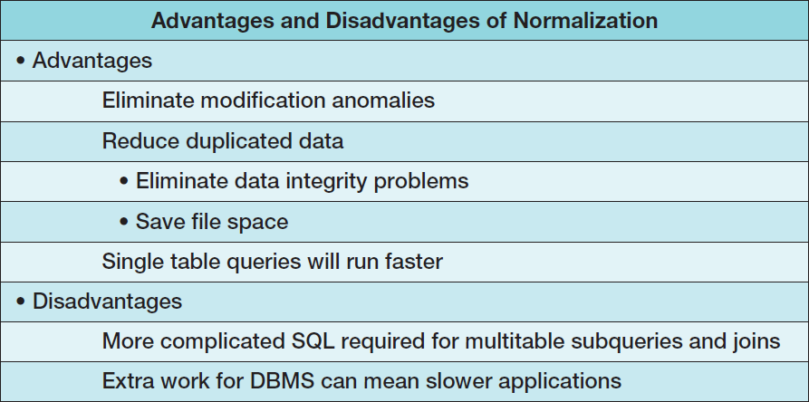
Normalization: Advantages and Disadvantages
Notes:
Why do we say reduce data duplication rather than eliminate data duplication?
The answer is that we cannot eliminate all duplicated data because we must duplicate data in foreign keys.
We cannot eliminate Buyer, for example, from the SKU_DATA table because we would then not be able to relate BUYER and SKU_DATA rows. Values of Buyer are thus duplicated in the BUYER and SKU_DATA tables.
This observation leads to a second question: If we only reduce data duplication, how can we claim to eliminate inconsistent data values? Data duplication in foreign keys will not cause inconsistencies because referential integrity constraints prohibit them.
As long as we enforce such constraints, the duplicate foreign key values will cause no inconsistencies.

Slide 14
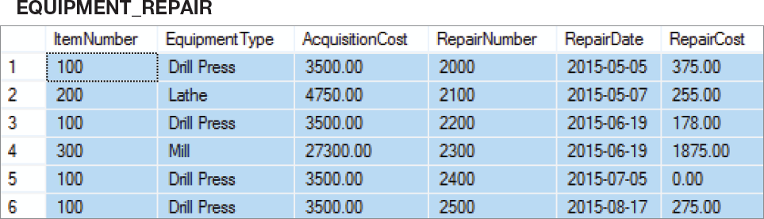
Non-Normalized Table: EQUIPMENT_REPAIR

Slide 15
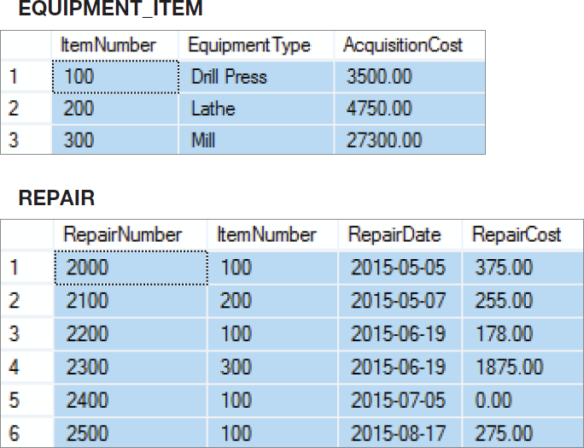
Normalized Tables: ITEM and REPAIR

Slide 16
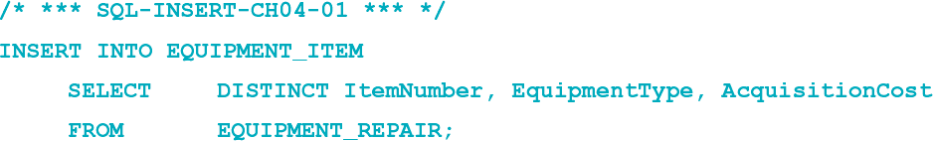
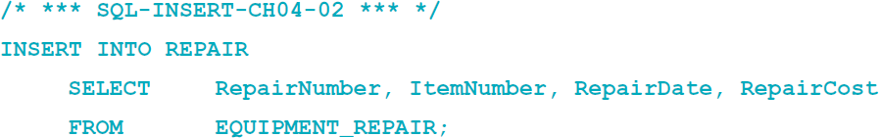
Copying Data to New Tables
To copy data from one table to another, use the SQL INSERT statement:

Slide 17
Final Steps
In Chapters 7 and 8, you will learn how to:
Remove unneeded tables after the data is copied, using the SQL DROP TABLE statement.
Create the referential integrity constraint, using the SQL ALTER TABLE statement.

Slide 18
Choosing Not To Use BCNF
BCNF is used to control anomalies from functional dependencies.
There are times when BCNF is not desirable.
The classic example is ZIP codes:
ZIP codes almost never change.
Any anomalies are likely to be caught by normal business practices.
Not having to use SQL to join data in two tables will speed up application processing.

Slide 19
Multivalued Dependencies
Anomalies from multivalued dependencies are very problematic.
Always place the columns of a multivalued dependency into a separate table (4NF).

Slide 20
Designing Read-Only Databases
The extracted sales data that we used for Cape Codd Outdoor Sports in Chapter 2 is a small, but typical example of a read-only database.
Read-only databases are used in business intelligence (BI) systems for producing information for assessment, analysis, planning, and control, as we discussed for Cape Codd Outdoor Sports in Chapter 2.
Read-only databases are commonly used in a data warehouse, which we also introduced in Chapter 2.

Slide 21
Read-Only Databases
Read-only databases are nonoperational databases using data extracted from operational databases.
They are used for querying, reporting, and data mining applications.
They are never updated (in the operational database sense—they may have new data imported from time to time).

Slide 22
Denormalization
For read-only databases, normalization is seldom an advantage.
Application processing speed is more important.
Denormalization is the joining of the data in normalized tables prior to storing the data.
The data is then stored in nonnormalized tables.

Slide 23
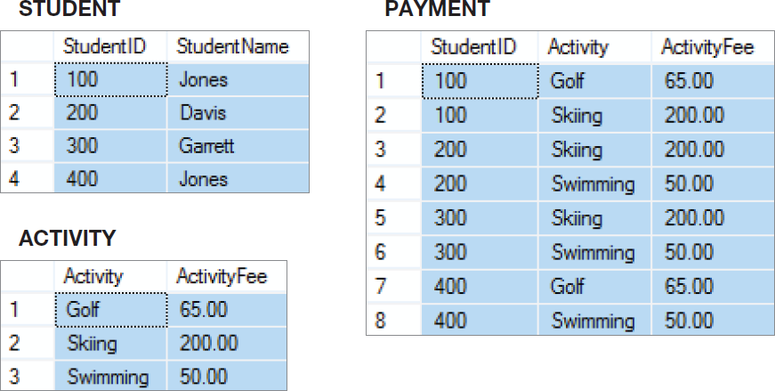
Normalized Tables

Slide 24
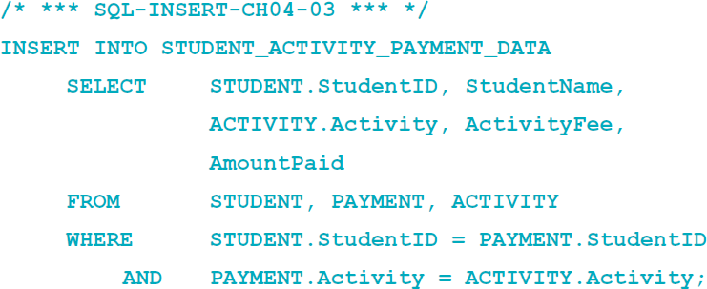
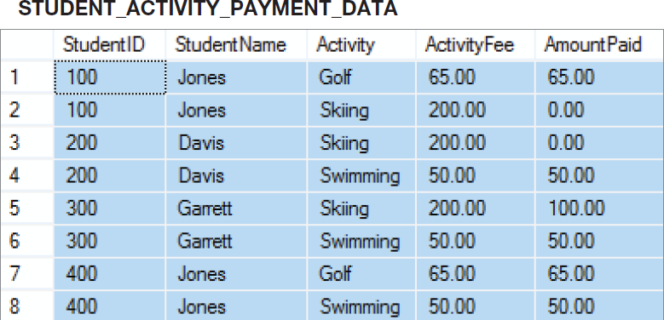
Denormalizing the Data

Slide 25
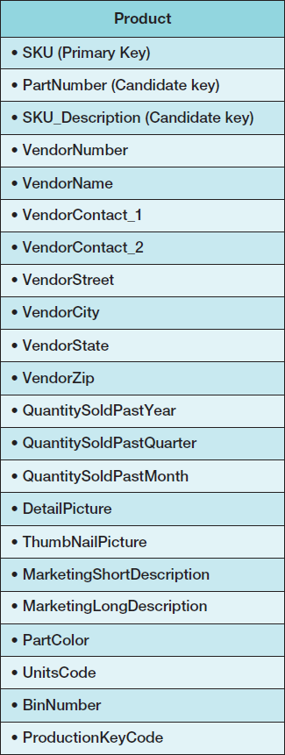
Customized Tables I
Read-only databases are often designed with many copies of the same data, but with each copy customized for a specific application.
Consider the PRODUCT table:

Slide 26
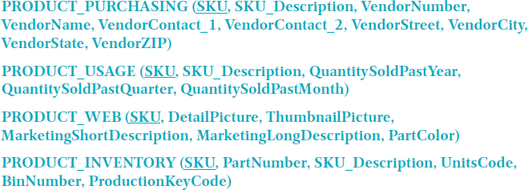
Customized Tables II

Slide 27
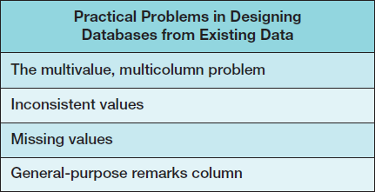
Common Design Problems

Slide 28
The Multivalue, Multicolumn Problem
The multivalue, multicolumn problem occurs when multiple values of an attribute are stored in more than one column:
EMPLOYEE (EmployeeNumber, EmployeeLastName, Auto2_LicenseNumber, Auto3_LicenseNumber)
This is another form of a multivalued dependency.
Solution = like the 4NF solution for multivalued dependencies, use a separate table to store the multiple values.

Slide 29
Inconsistent Values I
Inconsistent values occur when different users, or different data sources, use slightly different forms of the same data value:
Different codings:
SKU_Description = 'Corn, Large Can'
SKU_Description = 'Can, Corn, Large'
SKU_Description = 'Large Can Corn‘
Different spellings:
Coffee, Cofee, Coffeee

Slide 30
Inconsistent Values II
Particularly problematic are primary or foreign key values.
To detect:
Use referential integrity check already discussed for checking keys.
Use the SQL GROUP BY clause on suspected columns.

Slide 31
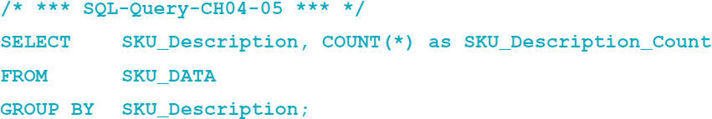
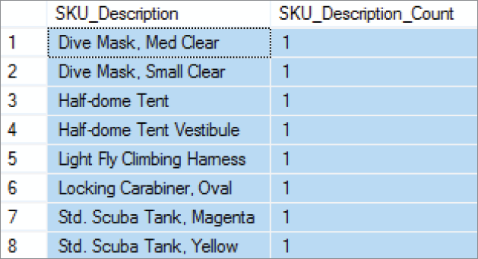
Inconsistent Values III

Slide 32
Missing Values
A missing value or null value is a value that has never been provided.
In a database table, a null value appears in upper case letters as NULL.

Slide 33
Null Values
Null values are ambiguous:
May indicate that a value is inappropriate;
DateOfLastChildbirth is inappropriate for a male.
May indicate that a value is appropriate but unknown;
DateOfLastChildbirth is appropriate for a female, but may be unknown.
May indicate that a value is appropriate and known, but has never been entered;
DateOfLastChildbirth is appropriate for a female, and may be known but no one has recorded it in the database.

Slide 34
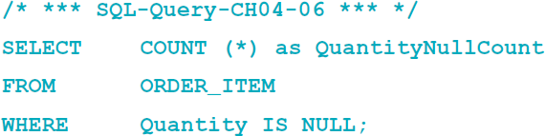

Checking for Null Values
Use the SQL IS NULL operator to check for null values:

Slide 35
The General-Purpose Remarks Column
A general-purpose remarks column is a column with a name such as:
Remarks
Comments
Notes
It often contains important data stored in an inconsistent, verbal, and verbose way.
A typical use is to store data on a customer’s interests.
Such a column may:
Be used inconsistently
Hold multiple data items

Slide 36
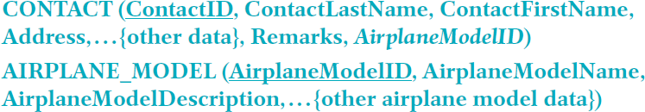
The General-Purpose Remarks Column: Hidden Foreign Key Data
In a typical situation, the data for the foreign key may have been recorded in the Remarks column.
'Wants to buy a Piper Seneca II‘
'Owner of a Piper Seneca II‘
'Possible buyer for a turbo Seneca'.

Slide 37
David Kroenke and David Auer Database Processing Fundamentals, Design, and Implementation (14th Edition)
End of Presentation:
Chapter Four

Slide 38

All rights reserved. No part of this publication may be reproduced, stored in a retrieval system, or transmitted, in any form or by any means, electronic, mechanical, photocopying, recording, or otherwise, without the prior written permission of the publisher. Printed in the United States of America.

